Slide 1
Mathematical Methods for Scientific Computing
Introduction and Vector Calculus
Stephen Millmore
Laboratory for Scientific Computing,
University of Cambridge

Slide 2
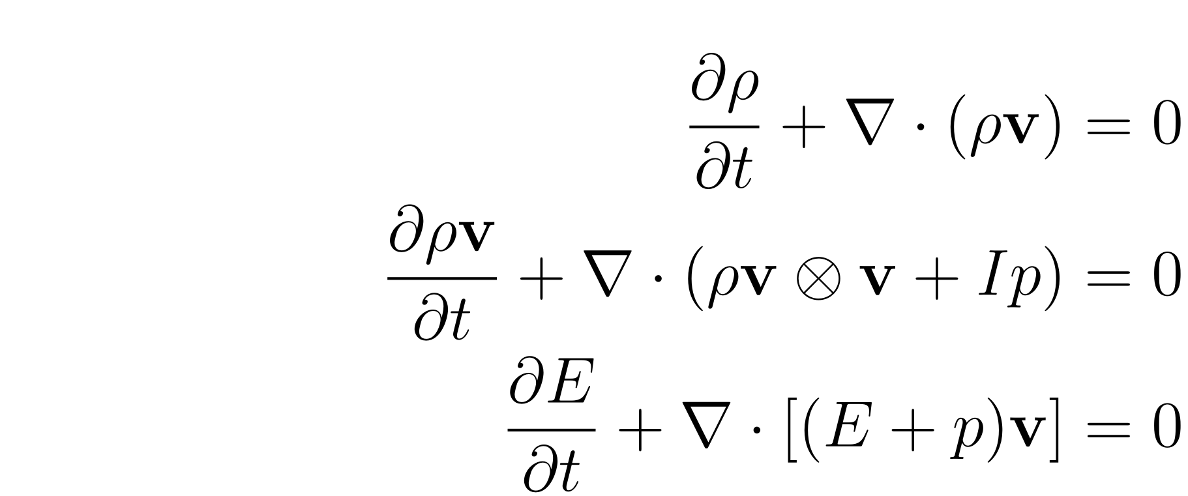
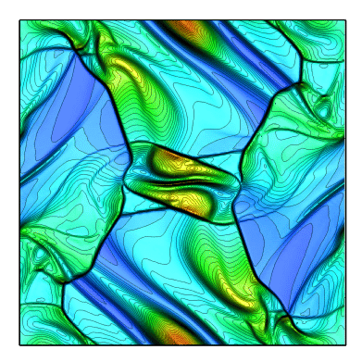
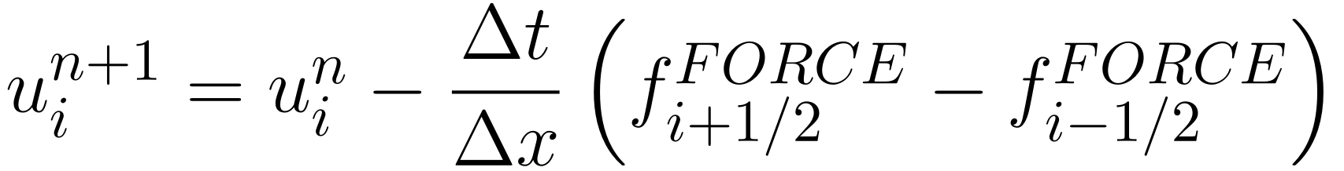
Mathematical methods for scientific computing
Scientific computing could be considered the field of turning equations into code, to solve problems which are otherwise intractable
We start with a system of equations, e.g. the compressible Euler equations
From these, numerical methods for their solution are developed
And finally, we get to simulation results
In order to derive, and understand the properties of these methods, we need appropriate mathematical techniques
You may see these equations rather a lot, and if you are not on the continuum stream you may not care about them, but they are my favourite equations so I keep using them

Slide 3
Mathematical methods for scientific computing
Throughout the MPhil in Scientific Computing, you will frequently need to use the mathematical techniques in this course — either for deriving or manipulating the equations you are going to solve, or for processing and understanding solution data
Some of this course is likely to have been covered in previous courses you will have taken, but that may have been a while ago, or approached in a different way
In this course, the aim is to set the methods lectured in the context of numerical methods and scientific computing
Accompanying this course are a series of problems — these will help reinforce the content of this course, but will likely take longer than the gap between lectures, so can be completed throughout term, and for revision

Slide 4
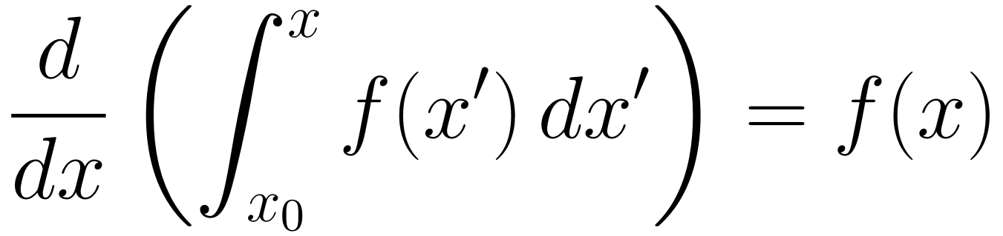
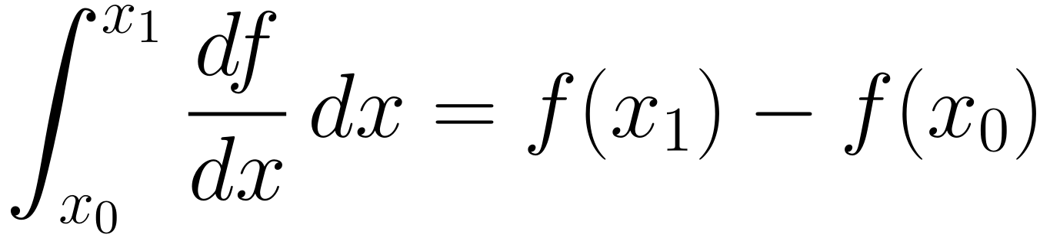
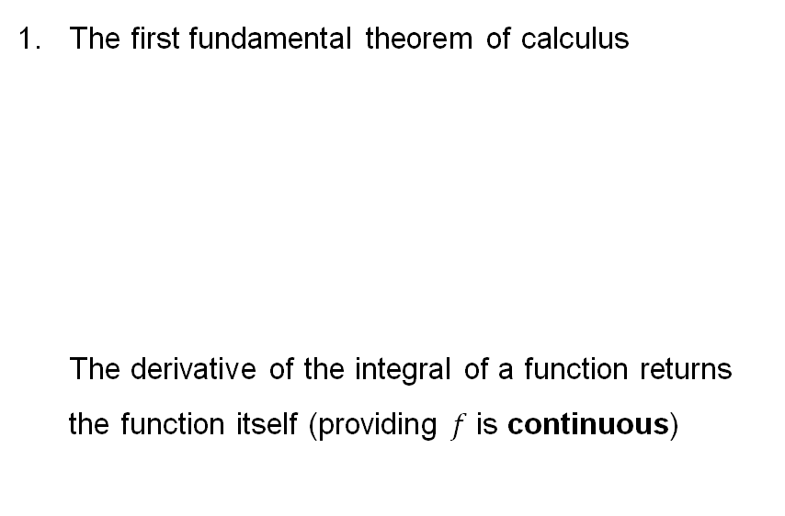
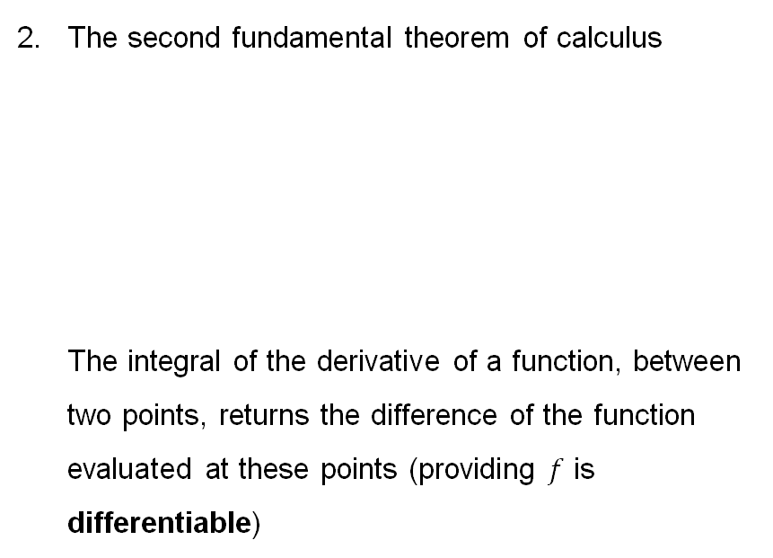
Assumed knowledge — calculus
Whilst this course will build on your previous maths background, it’s worth repeating a few of the key expressions which will be used repeatedly, just in case they’ve faded from memory a little
The first fundamental theorem of calculus
The derivative of the integral of a function returns the function itself (providing $f$ is continuous)
The second fundamental theorem of calculus
The integral of the derivative of a function, between two points, returns the difference of the function evaluated at these points (providing $f$ is differentiable)

Slide 5
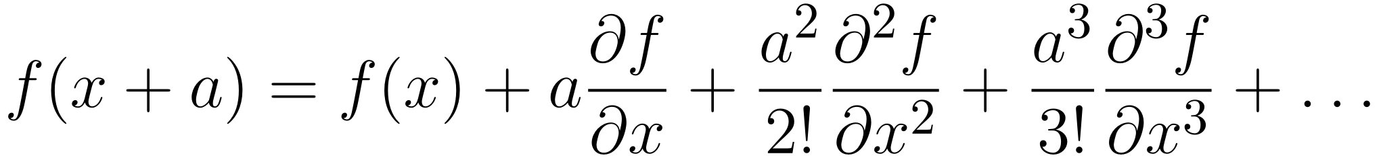
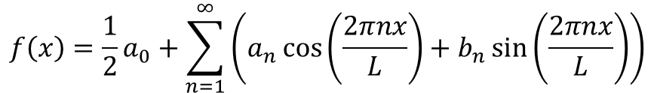
Assumed knowledge — series
Taylor series
Fourier series for a function with period L
$$f\left(x\right)=f\left(a\right)+{\left.\frac{∂f}{∂x}\right|}_{x=a}(x−a)+{\left.\frac{1}{2}\frac{∂^{2}f}{∂x^{2}}\right|}_{x=a}{(x−a)}^{2}+{\left.\frac{1}{3!}\frac{∂^{3}f}{∂x^{3}}\right|}_{x=a}{(x−a)}^{3}+…$$
$$f\left(x\right)=\frac{1}{2}a_{0}+\sum_{n=1}^{∞}{\left(a_{n}\cos\left(\frac{2πnx}{L}\right)+b_{n}\sin\left(\frac{2πnx}{L}\right)\right)}$$
$$a_{n}=\frac{2}{L}\int_{x_{0}}^{x_{0}+L}{f}\left(x\right)\cos\left(\frac{2πnx}{L}\right)dx, b_{n}=\frac{2}{L}\int_{x_{0}}^{x_{0}+L}{f}\left(x\right)\sin\left(\frac{2πnx}{L}\right)dx$$

Slide 6
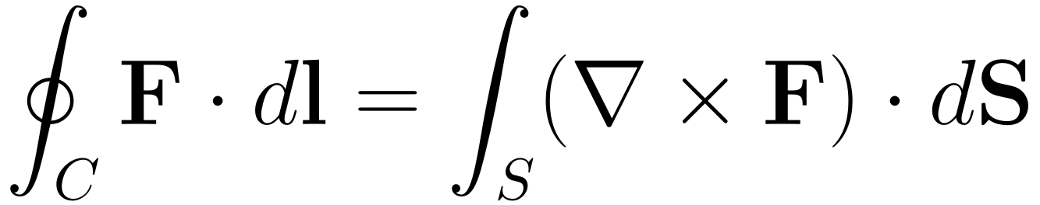
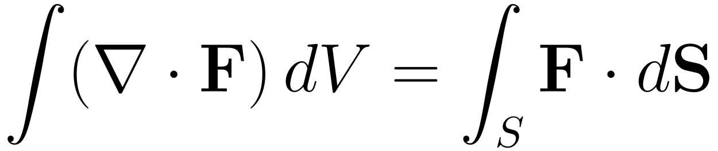
Assumed knowledge — further identities
Binomial expansion, in particular
Stokes' theorem
Divergence theorem
Note — despite the last two often being core components of vector calculus, we won't really use these here: they appear more in analytic calculations than computational ones

Slide 7
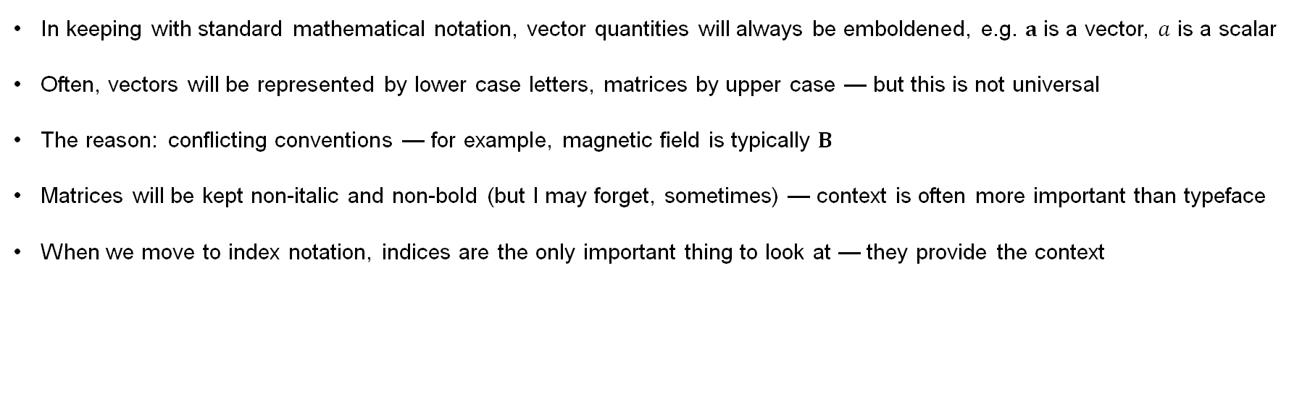
Notation note
In keeping with standard mathematical notation, vector quantities will always be emboldened, e.g. $a$ is a vector, $a$ is a scalar
Often, vectors will be represented by lower case letters, matrices by upper case — but this is not universal
The reason: conflicting conventions — for example, magnetic field is typically $B$
Matrices will be kept non-italic and non-bold (but I may forget, sometimes) — context is often more important than typeface
When we move to index notation, indices are the only important thing to look at — they provide the context

Slide 8
Outline
1. Vector calculus
2. Index notation
3. Tensors

Slide 9
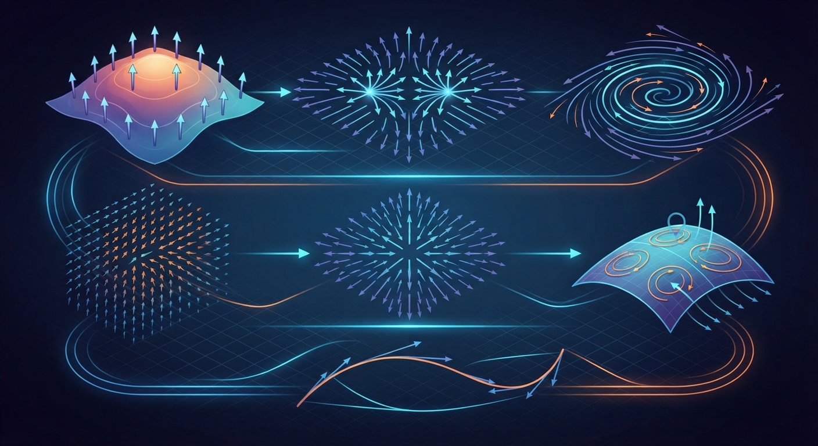
Vector Calculus

Slide 10



Vector calculus and evolution equations
The first topic we shall consider is vector calculus, with a key focus on index notation
When describing physical systems, we expect to find both vectors (velocity, relative position) and calculus (gradients, rates of change)
My favourite Euler equations are a good example of this:

Slide 11
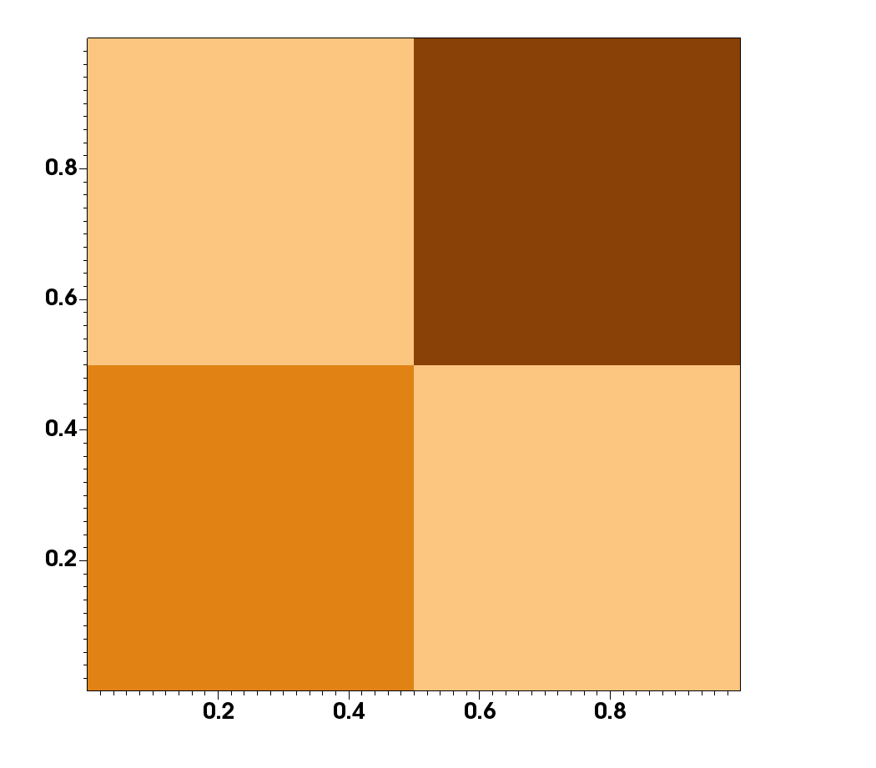
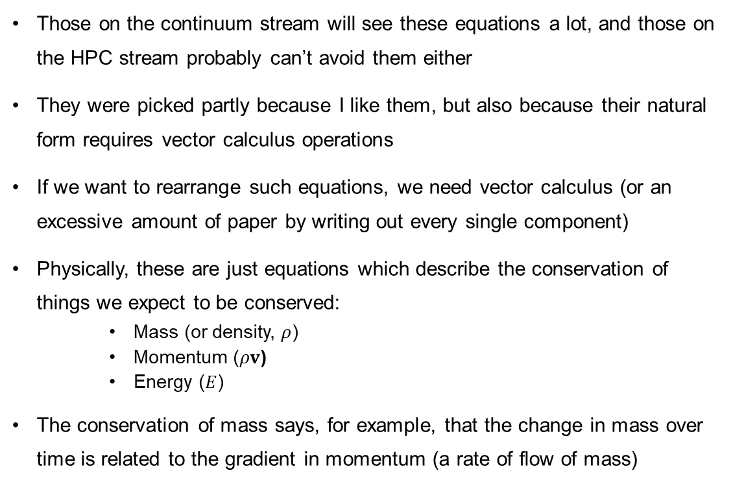

What are these equations?
Those on the continuum stream will see these equations a lot, and those on the HPC stream probably can’t avoid them either
They were picked partly because I like them, but also because their natural form requires vector calculus operations
If we want to rearrange such equations, we need vector calculus (or an excessive amount of paper by writing out every single component)
Physically, these are just equations which describe the conservation of things we expect to be conserved:
    Mass (or density, $ρ$)
    Momentum ($ρv$)
    Energy ($E$)
The conservation of mass says, for example, that the change in mass over time is related to the gradient in momentum (a rate of flow of mass)

Slide 12
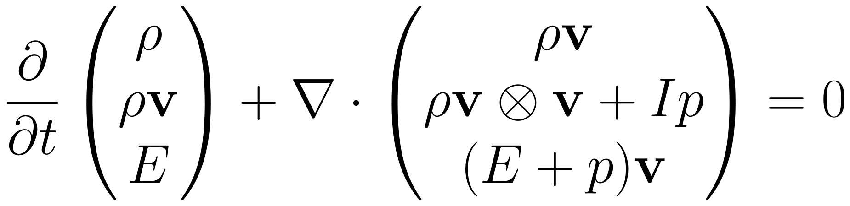
Vector form of equations
Real-world simulations typically cannot be described by a single variable; we need to consider the interaction of multiple variables in a coupled system
The density depends on the momentum, but the momentum itself also depends on density (and pressure)
It is therefore common to find these systems described in “vector form”

Slide 13
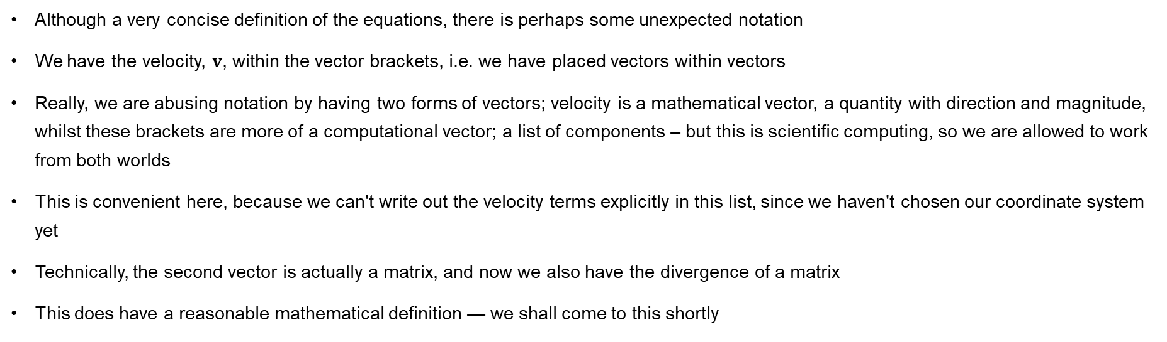
Unpacking this vector form
Although a very concise definition of the equations, there is perhaps some unexpected notation
We have the velocity, $v$, within the vector brackets, i.e. we have placed vectors within vectors
Really, we are abusing notation by having two forms of vectors; velocity is a mathematical vector, a quantity with direction and magnitude, whilst these brackets are more of a computational vector; a list of components – but this is scientific computing, so we are allowed to work from both worlds
This is convenient here, because we can't write out the velocity terms explicitly in this list, since we haven't chosen our coordinate system yet
Technically, the second vector is actually a matrix, and now we also have the divergence of a matrix
This does have a reasonable mathematical definition — we shall come to this shortly

Slide 14
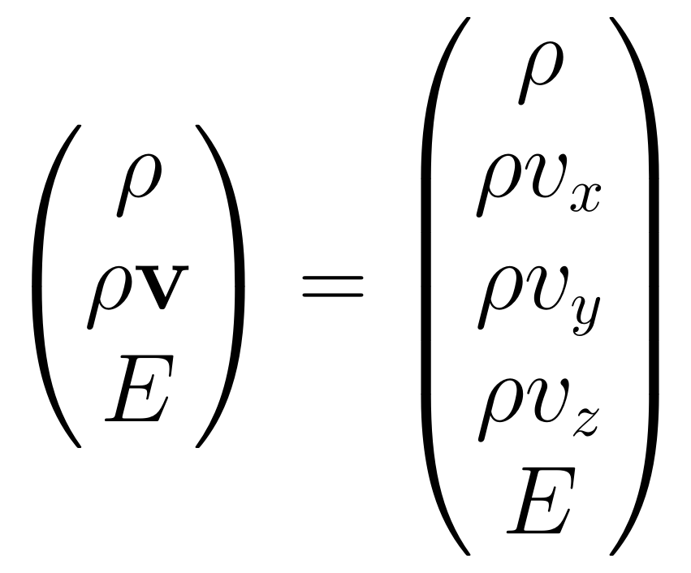
Coordinate-independent expressions
It is common to reduce dimensionality by appealing to symmetries, e.g. cylindrical symmetry
The vector-form equation holds regardless of whether
Once you know your coordinate system, you might be able to simply use a form like
However, this coordinate-independent approach hides an additional complication: when expressing the equation in your chosen coordinates, the basis vectors themselves might have non-zero derivatives

Slide 15
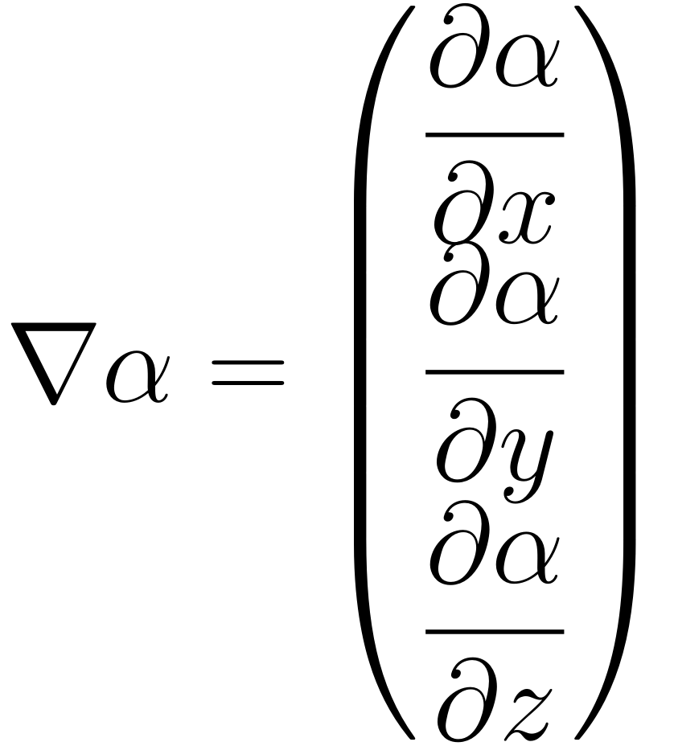
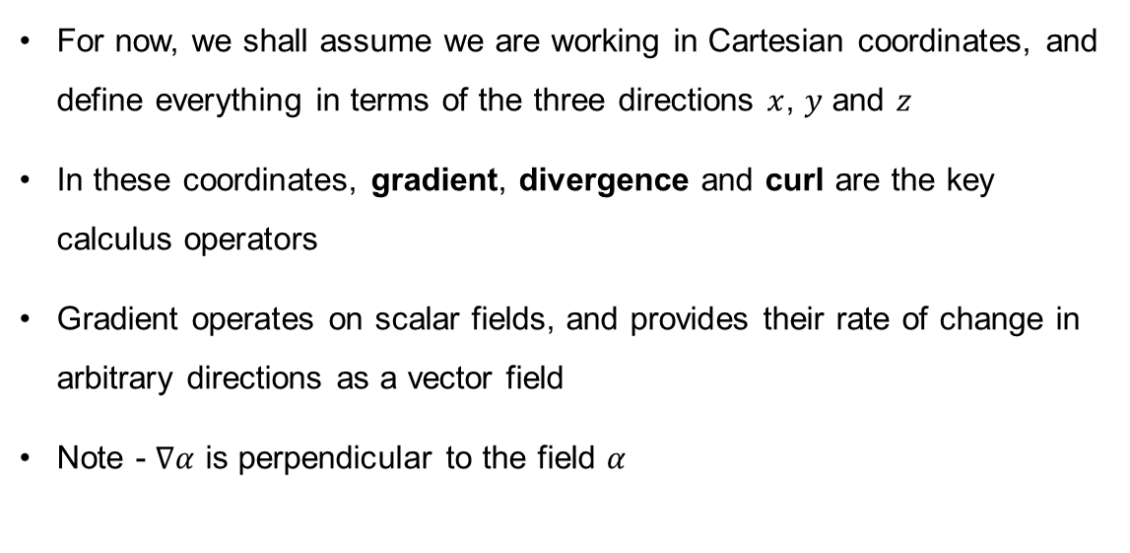
Quick review of vector operations — gradient
For now, we shall assume we are working in Cartesian coordinates, and define everything in terms of the three directions $x$, $y$ and $z$
In these coordinates, gradient, divergence and curl are the key calculus operators
Gradient operates on scalar fields, and provides their rate of change in arbitrary directions as a vector field
Note - $∇α$ is perpendicular to the field $α$

Slide 16
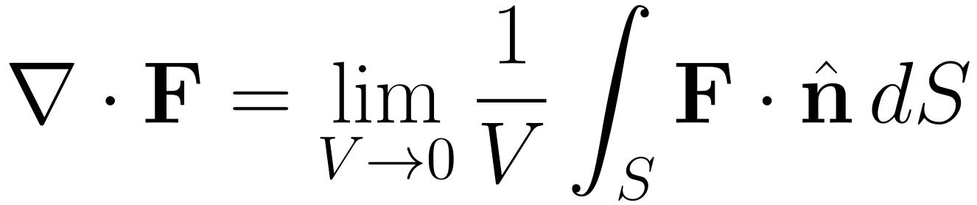
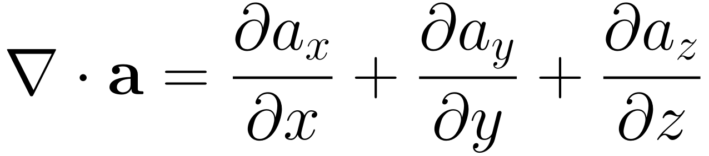
Quick review of vector operations — divergence
Divergence (div) can be considered the rate at which a vector field enters or leaves a given volume
This is why it appears in expressions like conservation of mass — it lets us track mass loss/gain in a volume
Mathematically, this is technically not a dot product, but it is nearly universally used this way

Slide 17
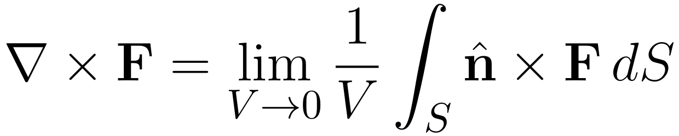
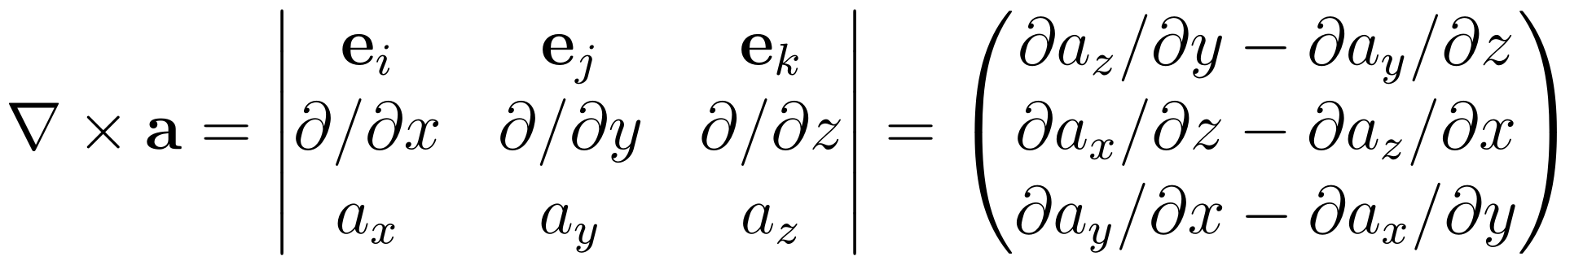
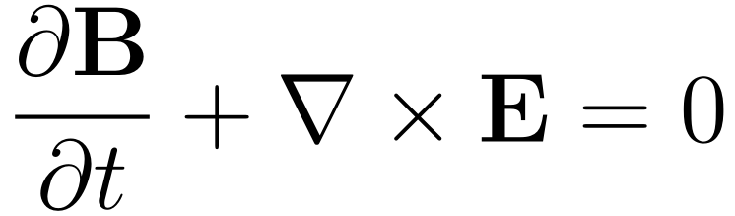
Quick review of vector operations — curl
Curl is a measure of circulation — related to the rate of rotation, not directly to the rotation itself
It also has a definition as a limit of an integral
Commonly encountered with electric and magnetic fields, since these act perpendicularly to each other
Again, technically this is not a true cross product mathematically

Slide 18
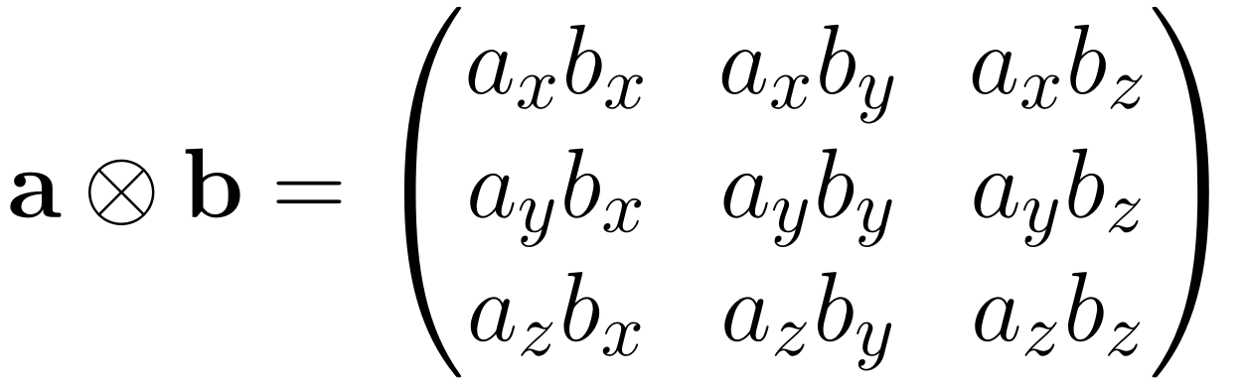
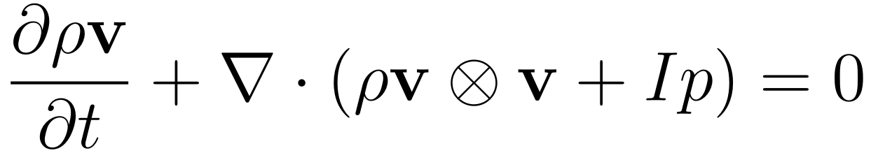
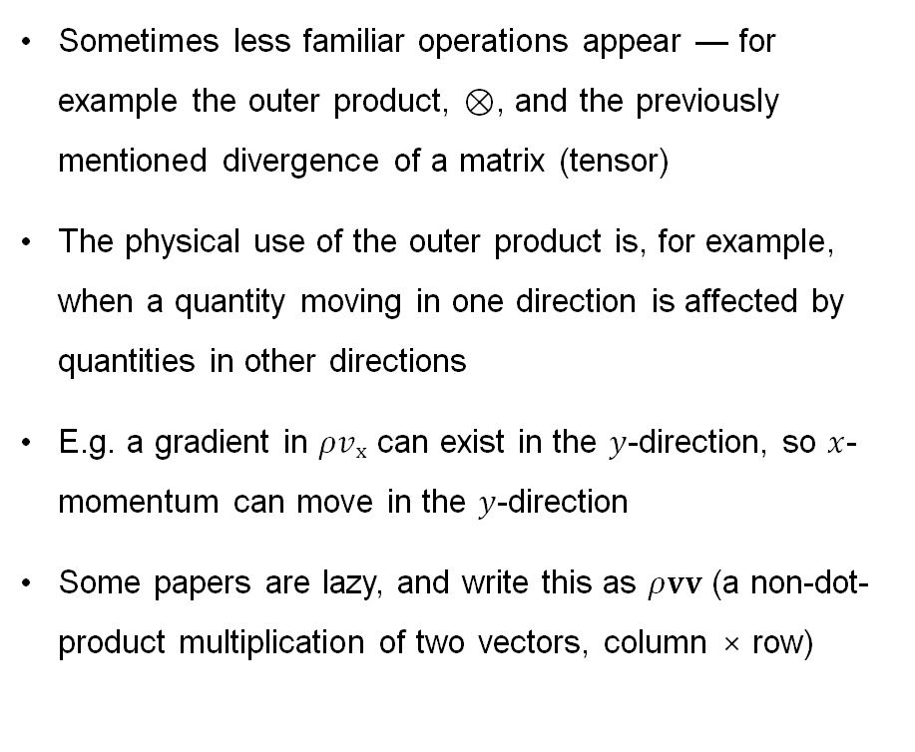
More vector operations — the outer product
Sometimes less familiar operations appear — for example the outer product, ⊗, and the previously mentioned divergence of a matrix (tensor)
The physical use of the outer product is, for example, when a quantity moving in one direction is affected by quantities in other directions
E.g. a gradient in $ρvₓ$ can exist in the $y$-direction, so $x$-momentum can move in the $y$-direction
Some papers are lazy, and write this as $ρvv$ (a non-dot-product multiplication of two vectors, column × row)

Slide 19
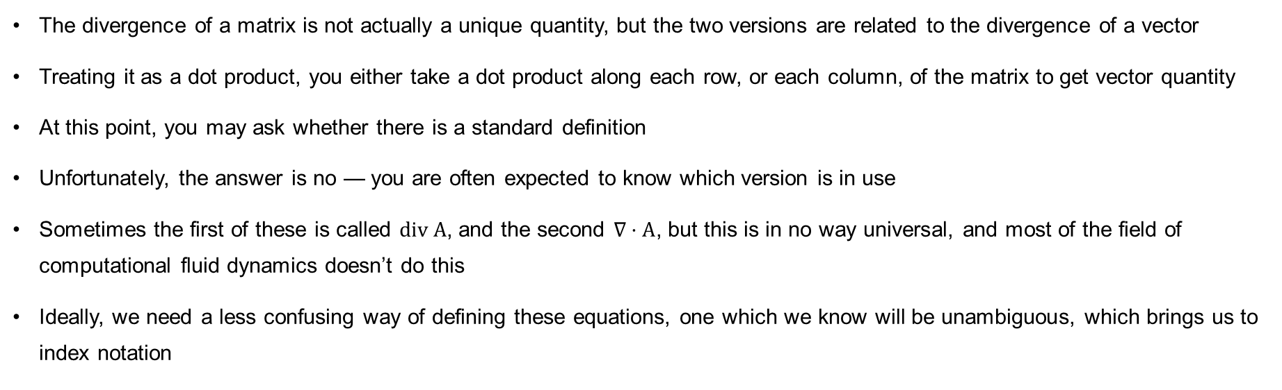
More vector operations - the divergence of a matrix
$$∇·A=\left(\begin{aligned}{∂A_{xx}}/{∂x}+{∂A_{xy}}/{∂y}+{∂A_{xz}}/{∂z} \\ {∂A_{yx}}/{∂x}+{∂A_{yy}}/{∂y}+{∂A_{yz}}/{∂z} \\ {∂A_{zx}}/{∂x}+{∂A_{zy}}/{∂y}+{∂A_{zz}}/{∂z}\end{aligned}\right) or ∇·A=\left(\begin{aligned}{∂A_{xx}}/{∂x}+{∂A_{yx}}/{∂y}+{∂A_{zx}}/{∂z} \\ {∂A_{xy}}/{∂x}+{∂A_{yy}}/{∂y}+{∂A_{zy}}/{∂z} \\ {∂A_{xz}}/{∂x}+{∂A_{yz}}/{∂y}+{∂A_{zz}}/{∂z}\end{aligned}\right) ?$$
The divergence of a matrix is not actually a unique quantity, but the two versions are related to the divergence of a vector
Treating it as a dot product, you either take a dot product along each row, or each column, of the matrix to get vector quantity
At this point, you may ask whether there is a standard definition
Unfortunately, the answer is no — you are often expected to know which version is in use
Sometimes the first of these is called $div A$, and the second $∇·A$, but this is in no way universal, and most of the field of computational fluid dynamics doesn’t do this
Ideally, we need a less confusing way of defining these equations, one which we know will be unambiguous, which brings us to index notation

Slide 20
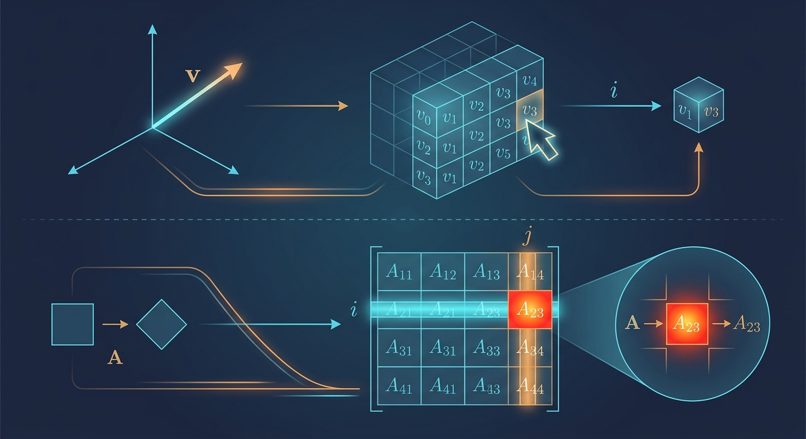
Index Notation

Slide 21
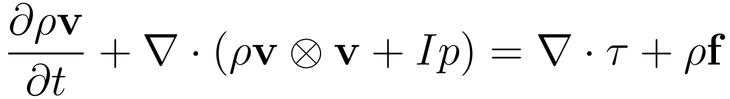
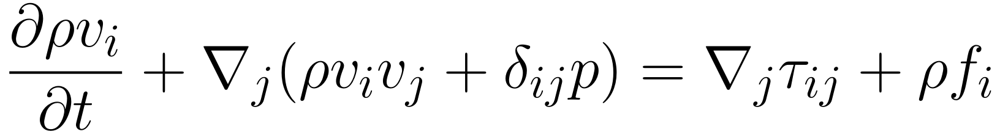
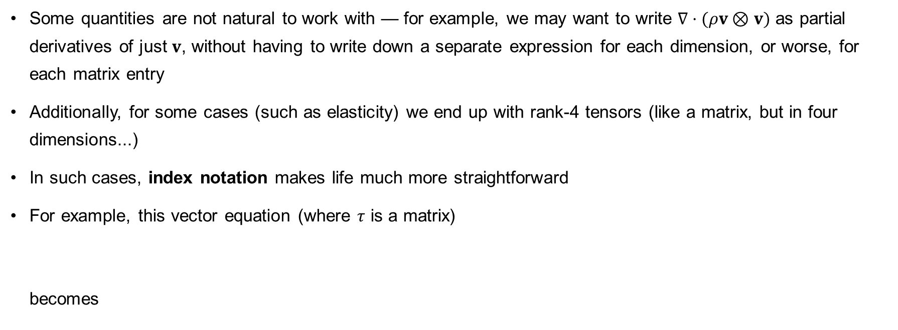
Index notation
Some quantities are not natural to work with — for example, we may want to write $∇·(ρv⊗v)$ as partial derivatives of just $v$, without having to write down a separate expression for each dimension, or worse, for each matrix entry
Additionally, for some cases (such as elasticity) we end up with rank-4 tensors (like a matrix, but in four dimensions...)
In such cases, index notation makes life much more straightforward
For example, this vector equation (where $τ$ is a matrix)
becomes

Slide 22
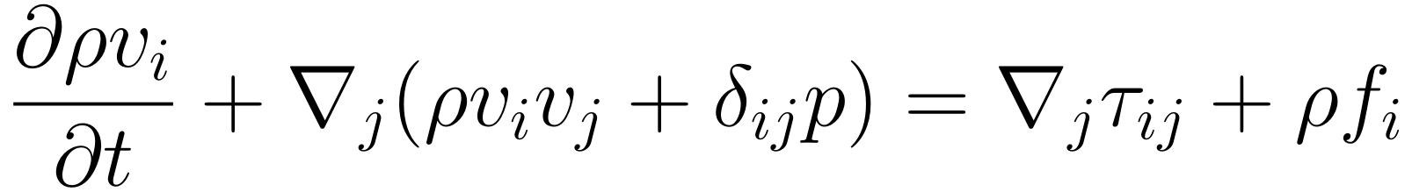
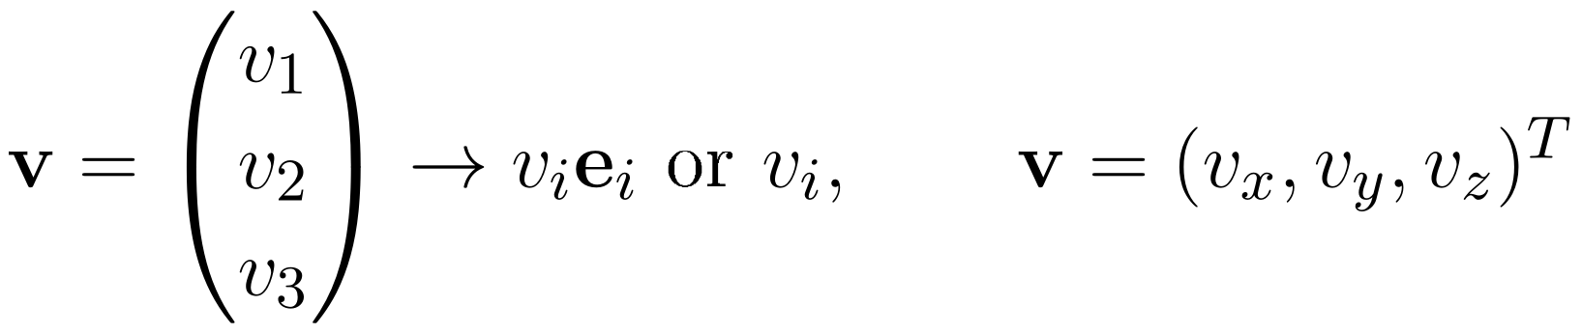
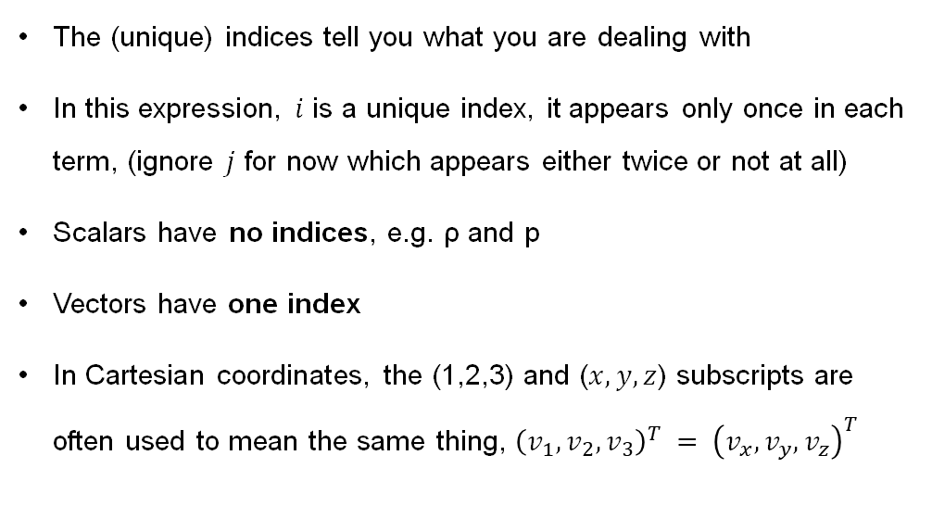
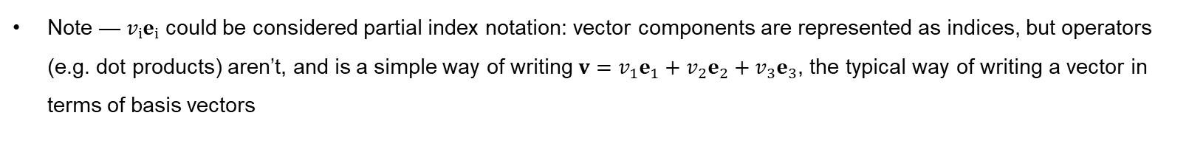
Reading index notation — scalars and vectors
The (unique) indices tell you what you are dealing with
In this expression, $i$ is a unique index, it appears only once in each term, (ignore $j$ for now which appears either twice or not at all)
Scalars have no indices, e.g. ρ and p
Vectors have one index
In Cartesian coordinates, the (1,2,3) and ($x,y,z$) subscripts are often used to mean the same thing, ${\left(v_{1},v_{2},v_{3}\right)}^{T} = {\left(v_{x},v_{y},v_{z}\right)}^{T}$
Note — $vᵢeᵢ$ could be considered partial index notation: vector components are represented as indices, but operators (e.g. dot products) aren’t, and is a simple way of writing $v=v_{1}e_{1}+v_{2}e_{2}+v_{3}e_{3}$, the typical way of writing a vector in terms of basis vectors

Slide 23
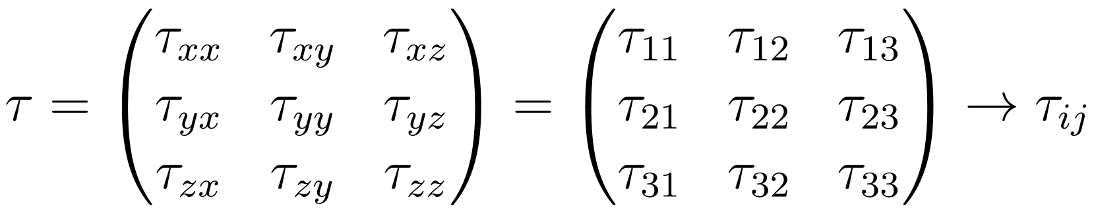
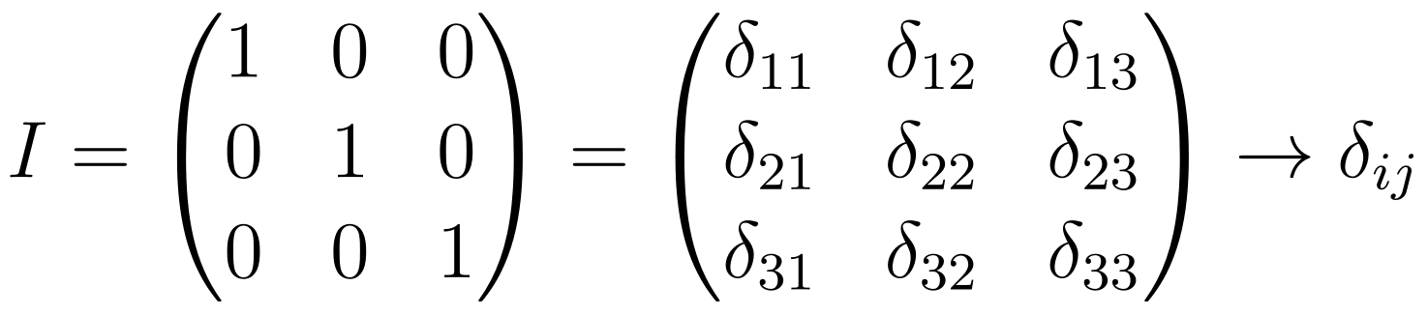
Reading index notation — matrices
Matrices have two indices: the first gives the row, the second gives the column
The identity matrix, written in index notation, is typically called the Kronecker delta

Slide 24
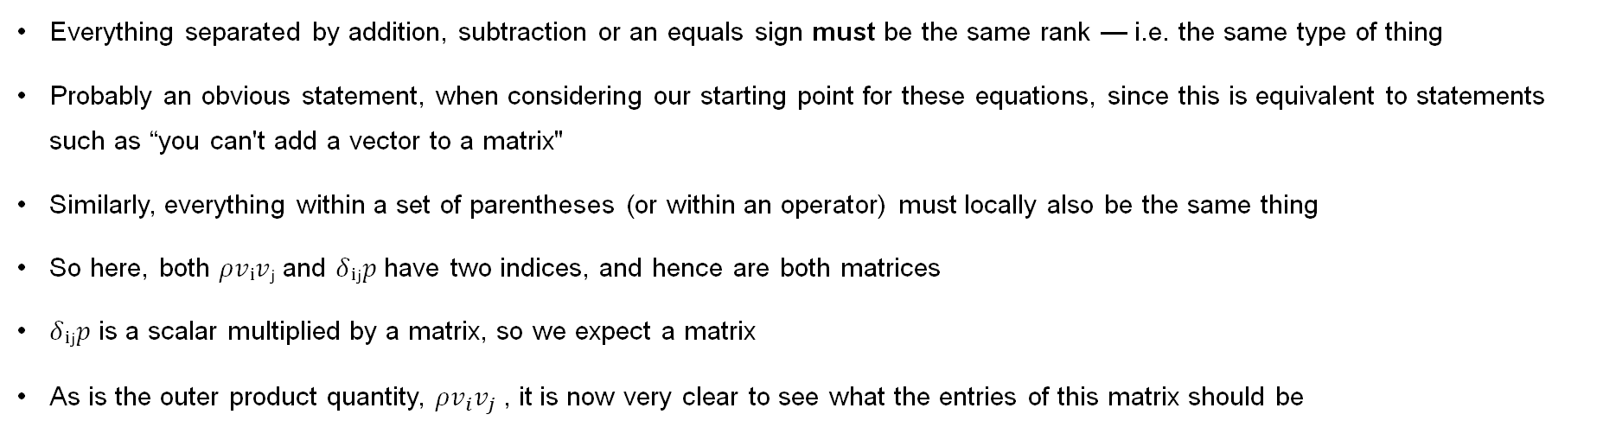
Combined quantities
Everything separated by addition, subtraction or an equals sign must be the same rank — i.e. the same type of thing
Probably an obvious statement, when considering our starting point for these equations, since this is equivalent to statements such as “you can't add a vector to a matrix"
Similarly, everything within a set of parentheses (or within an operator) must locally also be the same thing
So here, both $ρvᵢvⱼ$ and $δᵢⱼp$ have two indices, and hence are both matrices
$δᵢⱼp$ is a scalar multiplied by a matrix, so we expect a matrix
As is the outer product quantity, $ρv_{i}v_{j}$ , it is now very clear to see what the entries of this matrix should be

Slide 25
Addition and vector size

Slide 26
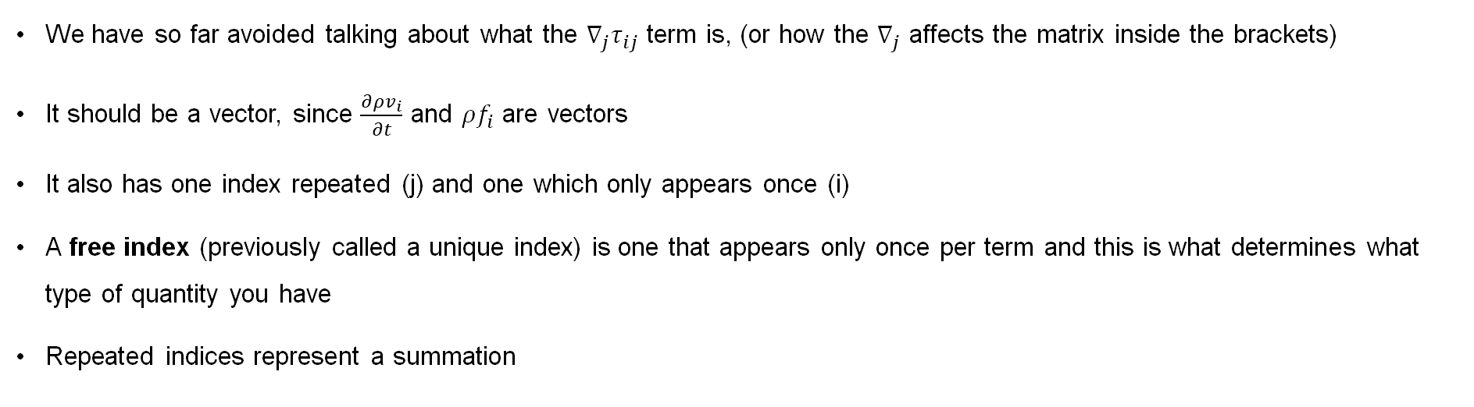
Free indices
We have so far avoided talking about what the $∇_{j}τ_{ij}$ term is, (or how the $∇_{j}$ affects the matrix inside the brackets)
It should be a vector, since $\frac{∂ρv_{i}}{∂t}$ and $ρf_{i}$ are vectors
It also has one index repeated (j) and one which only appears once (i)
A free index (previously called a unique index) is one that appears only once per term and this is what determines what type of quantity you have
Repeated indices represent a summation

Slide 27
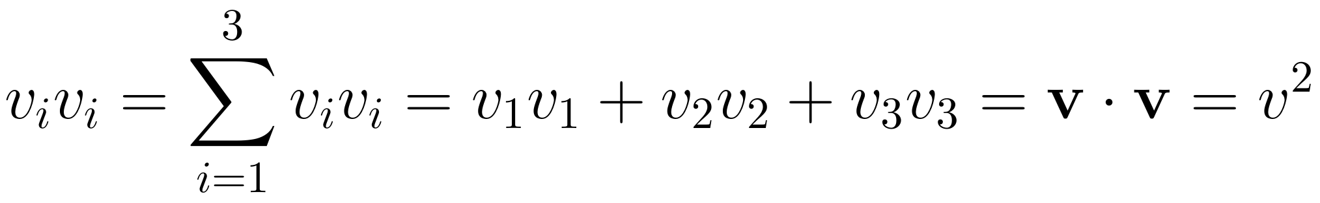
Repeated indices
Repeated indices represent a sum over that index — the Einstein summation convention
Used for simplifying notation – we can end up with a lot of repeated indices in expressions, and writing out the sum every time (especially for nested summation) gets tiring
This index can be repeated in two different quantities (such as the dot product above), or within a single quantity, as in Hooke's law for stress and strain

Slide 28
Dummy indices
For free indices, the position of the index letter must be used consistently — for example these are all different quantities

Slide 29
Index position

Slide 30
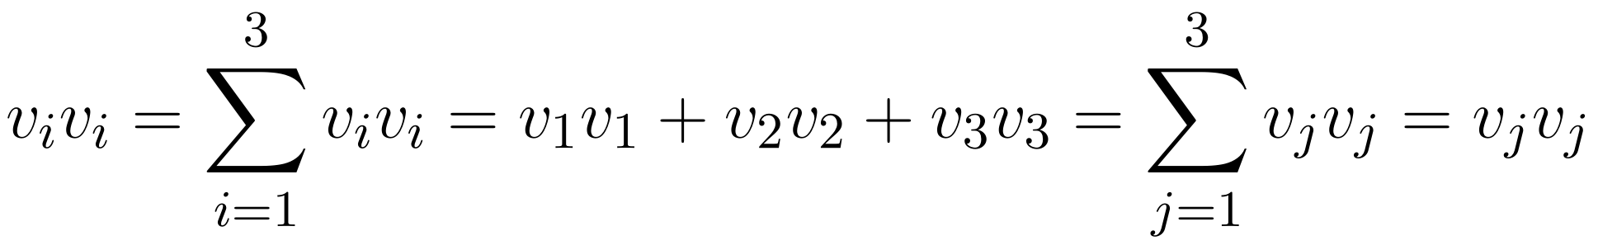
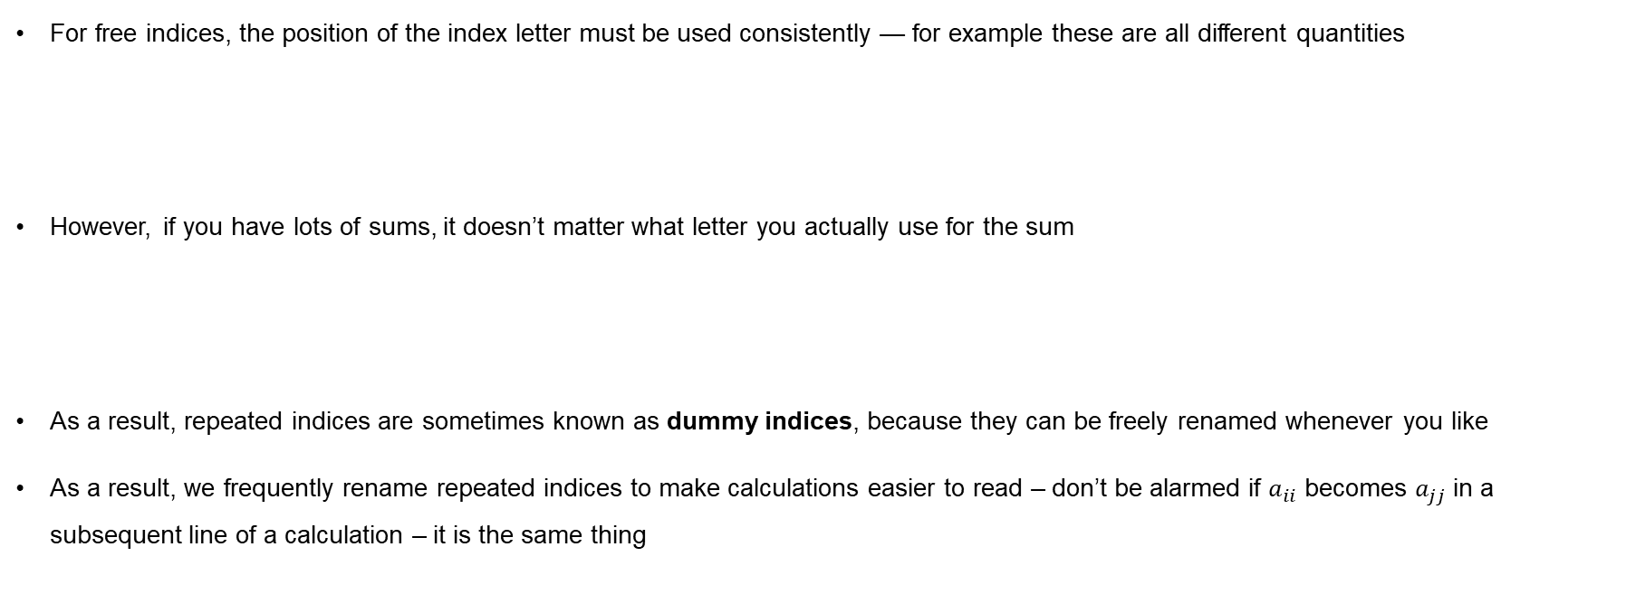
Dummy indices
For free indices, the position of the index letter must be used consistently — for example these are all different quantities
However, if you have lots of sums, it doesn’t matter what letter you actually use for the sum
As a result, repeated indices are sometimes known as dummy indices, because they can be freely renamed whenever you like
As a result, we frequently rename repeated indices to make calculations easier to read – don’t be alarmed if $a_{ii}$ becomes $a_{jj}$ in a subsequent line of a calculation – it is the same thing

Slide 31

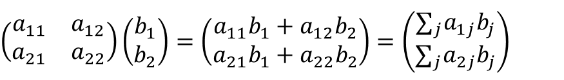

Vector and matrix multiplication
We have sort of introduced this already with the dot product and the summation convention
But, unsurprisingly, since vector-matrix and matrix-matrix multiplication involve summation over rows or columns, so these can be described using index notation too
For example, since
we can easily see this can be written
Similarly
$$\left(\begin{matrix}a_{11} & a_{12} \\ a_{21} & a_{22}\end{matrix}\right)\left(\begin{matrix}b_{1} \\ b_{2}\end{matrix}\right)=\left(\begin{matrix}a_{11}b_{1}+a_{12}b_{2} \\ a_{21}b_{1}+a_{22}b_{2}\end{matrix}\right)=\left(\begin{matrix}∑_{j}a_{1j}b_{j} \\ ∑_{j}a_{2j}b_{j}\end{matrix}\right)$$
$$Ab→A_{ij}b_{j},$$
$$AB→A_{ij}B_{jk}$$

Slide 32
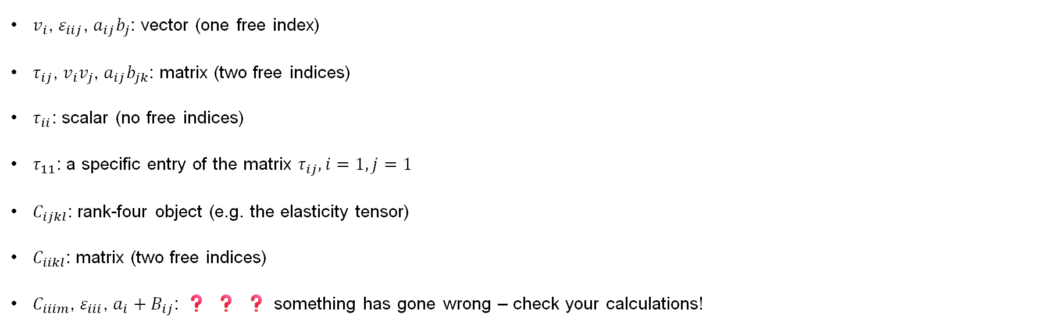
Indices — summary
$v_{i}$, $ε_{iij}$, $a_{ij}b_{j}$: vector (one free index)
$τ_{ij}$, $v_{i}v_{j}$, $a_{ij}b_{jk}$: matrix (two free indices)
$τ_{ii}$: scalar (no free indices)
$τ_{11}$: a specific entry of the matrix $τ_{ij}, i=1, j=1$
$C_{ijkl}$: rank-four object (e.g. the elasticity tensor)
$C_{iikl}$: matrix (two free indices)
$C_{iiim}$, $ε_{iii}$, $a_{i}+B_{ij}$: ❓ ❓ ❓ something has gone wrong – check your calculations!

Slide 33
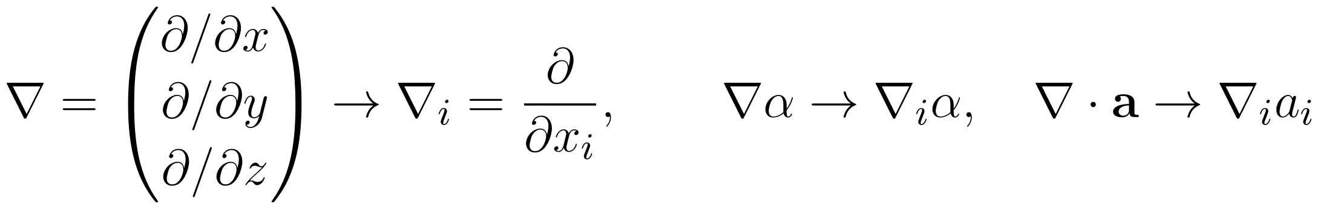
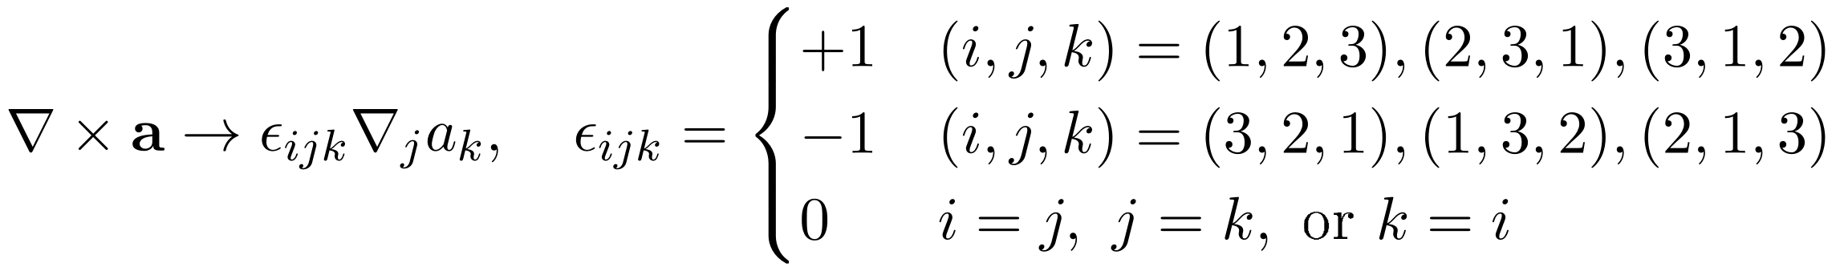
Back to grad, div and curl
The grad operator, ∇, is a vector operator, so can be written with index notation
Grad and div are now straightforward
Curl requires the addition of a new quantity, the Levi-Civita symbol

Slide 34
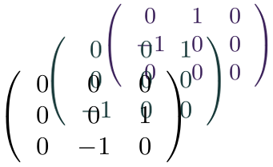
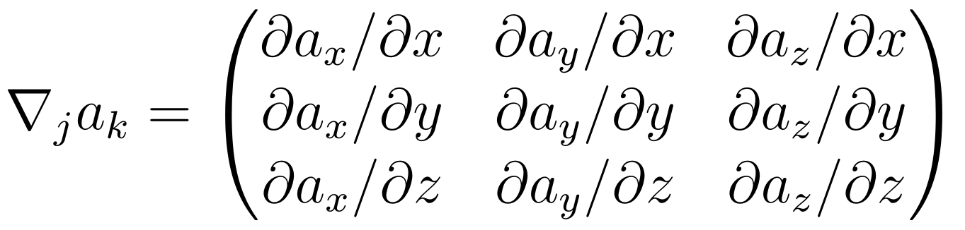



The Levi-Civita symbol
$$∇×a=ε_{ijk}∇_{j}a_{k}$$
There is one free index in $ε_{ijk}∇_{j}a_{k}$, so, as expected, this is a vector term
The term $∇_{j}a_{k}$ is a matrix, and the Levi-Civita symbol a ‘3-D matrix’
The quantity $ε_{ijk}∇_{j}a_{k}$ then multiplies each ‘slice’ of $ε_{ijk}$ with $∇_{j}a_{k}$
Also note that any cross product is written in index notation with the Levi-Civita symbol,

Slide 35
Levi-Civita symbol

Slide 36
Levi-Civita symbol

Slide 37

Vector calculus in index notation
Working in index notation has a few advantages
Notation for matrices, and ‘higher dimensional matrices’, is straightforward, and there is no other universal convention for these quantities
Simplification of expressions is also more straightforward — there is no need to memorise any relationships
Well, maybe one:
Dealing with derivatives is a lot easier too
This is all because in index notation you are treating everything at the level of a scalar quantity, which means you can re-order things mid-calculation without having to worry about what this quantity actually is, or whether it would make sense written down (we shall see some examples of this soon)

Slide 38

Changing indices with the Kronecker delta
One of the key features of vector calculus operations in index notation is using the Kronecker delta to change indices
Sometimes this is obvious — multiplying a vector by the identity matrix does not change the vector
Sometimes it takes a bit more thought
And occasionally, we work backwards

Slide 39
Kronecker delta

Slide 40
Some examples
All ‘classic’ vector calculus identities can be demonstrated using index notation

Slide 41
Vector identities

Slide 42


Some examples
All ‘classic’ vector calculus identities can be demonstrated using index notation
Throughout the continuum courses, we will use index notation for expressing equations in ‘desired’ forms
For example, if we want to solve the Maxwell–Faraday equation (with a few other coupled equations, and using Ohm's law),
then it is often desirable to express all spatial derivatives through a divergence operator

Slide 43
Maxwell-Faraday equation

Slide 44


A disclaimer
Technically, index notation does not just use subscripts, but also superscripts
Because we tend to focus on Cartesian coordinates, we ignore this distinction (we have $a^{x}=a_{x}$ and so on)
But in more general coordinate systems this is not true, and a transformation is required to move between the two forms
We rarely encounter this in this MPhil; we even write non-Cartesian coordinates in a ‘Cartesian-like’ manner
Fusion plasma equilibrium literature is one notable exception — non-orthogonal coordinate systems are common in much of the traditional literature

Slide 45

Tensors

Slide 46




Tensors
Using index notation makes it easy to write down a ‘three-dimensional matrix’ in a straightforward way
It is common to refer to these sorts of quantities as tensors, though in reality, tensors have a slightly stricter definition
This starts with vectors, which are expressed in a given coordinate system through basis vectors
For example, we may have Cartesian basis vectors $e_{x}$, $e_{y}$, $e_{z}$, (often written $i$, $j$, $k$), or spherical polar basis vectors $e_{r}$, $e_{φ}$, $e_{θ}$
Coordinates transform through
$$a=a_{1}e_{1}+a_{2}e_{2}+a_{3}e_{3}$$
$$a=a′_{1}{e′}_{1}+a′_{2}{e′}_{2}+a′_{3}{e′}_{3}$$
Jacobian matrix, or just Jacobian
Note – these last two typically correspond specifically to rotation or linear transformation of a coordinate system

Slide 47
Vector transformation

Slide 48
Vector transformation

Slide 49
Vector transformation

Slide 50
Why do we care about tensors?
Vectors can always be transformed through the Jacobian
A tensor is a generalisation of this – any quantity that also transforms according to these transformation rules, e.g.
The number of indices is also known as its rank
One of the key aspects of a tensor is that the quantity represents the same physical thing, no matter what coordinate system we are working in (though individual entries will, of course, be different)
This is important for consistent definitions of quantities such as stress, or elastic deformation
Though perhaps easiest to understand through quantities such as speed, which is the magnitude of velocity; if computing the magnitude of a velocity in different coordinate systems gave different answers, it would not be a tensor (but, fortunately, this is not the case)
We see this importance in invariant quantities

Slide 51




Invariant quantities
Invariant quantities are those which are the same, no matter the coordinate system used to compute them
For a rank-2 tensor, the invariant quantities come from finding its eigenvalues (if you’ve forgotten what eigenvalues are, we will cover them in much more detail soon!)
This determinant can be written as a cubic equation with three coefficients
$I₁$, $I₂$ and $I₃$ are the invariants of a rank-2 tensor in 3D
$$I_{2}=\frac{1}{2}\left(a_{jj}−a_{ij}a_{ji}\right) =\frac{1}{2}\left[\left({tr\left(A\right)}^{2}−tr\left(A^{2}\right)\right)\right]$$
$$I_{1}=a_{ii}=a_{11}+a_{22}+a_{33}=tr\left(A\right)$$
$$I_{3}=det|A|$$

Slide 52



Invariants, pressure and stress
When modelling any continuum material, stress ($σ_{ij}$) is a rank-2 tensor which describes how the material is being pushed (or pulled) in any direction
Pressure ($p$) is a scalar quantity, which gives some information about how much stress the material is under
Perhaps unsurprisingly, the pressure experienced at any point within a material does not depend on the coordinate system used to calculate it — it is an invariant quantity
Source: By Nevit Dilmen - Self-photographed, CC BY-SA 3.0, https://commons.wikimedia.org/w/index.php?curid=3821227

Slide 53



Matrices which aren't tensors
Every rank-2 tensor is a matrix, but not every matrix is a tensor
Trivially, any matrix given just as numbers, but without a coordinate system, will not be a tensor
More importantly, though, there are two commonly encountered quantities which are matrices, relate obviously to coordinate directions, but are not tensors
The first is the coordinate transformation, or Jacobian
The second is the deformation gradient, Fᵢⱼ — this transforms an infinitesimal particle from its reference configuration $dX$ to its current position $dx$, by deformation (squashing and expanding) alone (no rotation or translation)

Slide 54

What are these matrices?
Both these examples take one vector ($e′$ or $X$) and transform it to a new vector ($e$ or $x$)
These quantities transform as vectors — i.e. would need one coordinate transform, whilst a regular rank-2 tensor would require two
On inspection, this is perhaps not surprising: when we perform a coordinate transformation, this would either be in the coordinates we started with or with the coordinates we end up with
Such quantities are known as two-point tensors (which, despite still having tensor in this name, does not make it a tensor), or double vectors
This name does not always make it to the literature, though...

Slide 55
Deformation gradient

